Slide 1


Slide 2
Experimental design
Dr. VIJAYALEKSHMI N S
ASSISTANT PROFESSOR
M.Ed DEPARTMENT
FATHIMA MEMORIAL TRAINING COLLEGE
KOLLAM, KERALA STATE

Slide 3
contents
Concept of Experimental Design
Purpose of Experimental Design
Basic steps in Experimental Design
Pre-experimental Designs
True Experimental Designs
Quasi-experimental Designs
Statistical Designs
Strengths of Experimental Design
Limitations of Experimental Design

Slide 4
Learning objectives
The student teachers will be able to,
define experimental research design
understand the concept of experimental research
describe the purpose of experimental design
list the basic steps of experimental design
differentiate various types of experimental designs
list the basic steps of quantitative design
analyse strengths and limitations of experimental design
identify the ethical issues involved in quantitative design

Slide 5
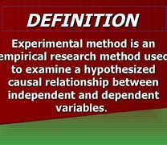
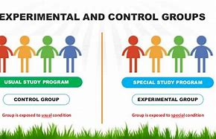
Experimental design

Slide 6
Experimental design- concept
Experimental research is a type of study which is commonly used in scientific research designs
It is the primary approach used to scrutinize the causal (cause/effect) relationships
Investigate the effect of independent variable on dependent variable
This kind of research is known as a hypothesis testing or a deductive research method
It is used to support or disprove the hypotheses which are formulated by the researcher to address a specific question or issue

Slide 7
Keywords in experimental research
Independent Variable
This variable will be manipulated, that can be called the “cause” or treatment variable
Dependent Variable
This variable is the “effect” or outcome of manipulating the independent variable. The crucial point here is that the outcome must be measurable
Experimental Group
It is the group that receives the treatment
Control Group
This is the group that remains fixed, and at the end, it is compared to the experimental group

Slide 8
Purpose of experimental design
Causation
It allows the experimenter to make causal inferences about the relationship between independent variables and a dependent variable
Control
It allows the experimenter to rule out alternative explanations due to the confounding effects of extraneous variables (i.e., variables other than the independent variables)
Variability
It reduces variability within treatment conditions, which makes it easier to detect differences in treatment outcomes

Slide 9
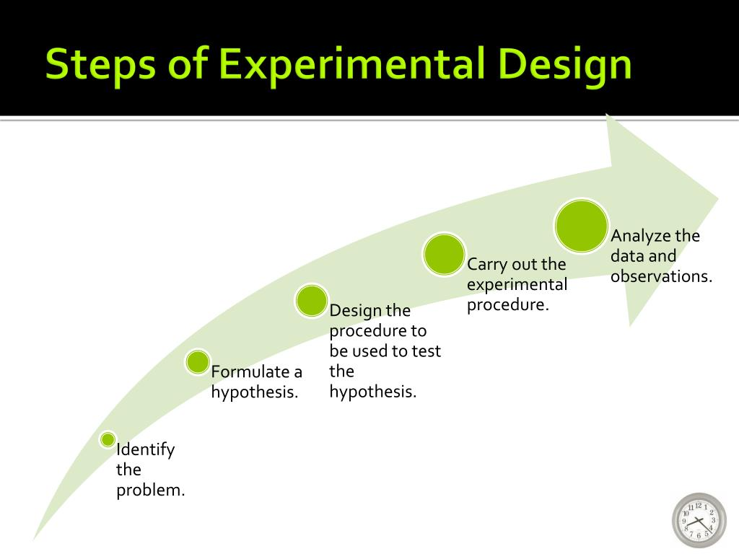

Slide 10
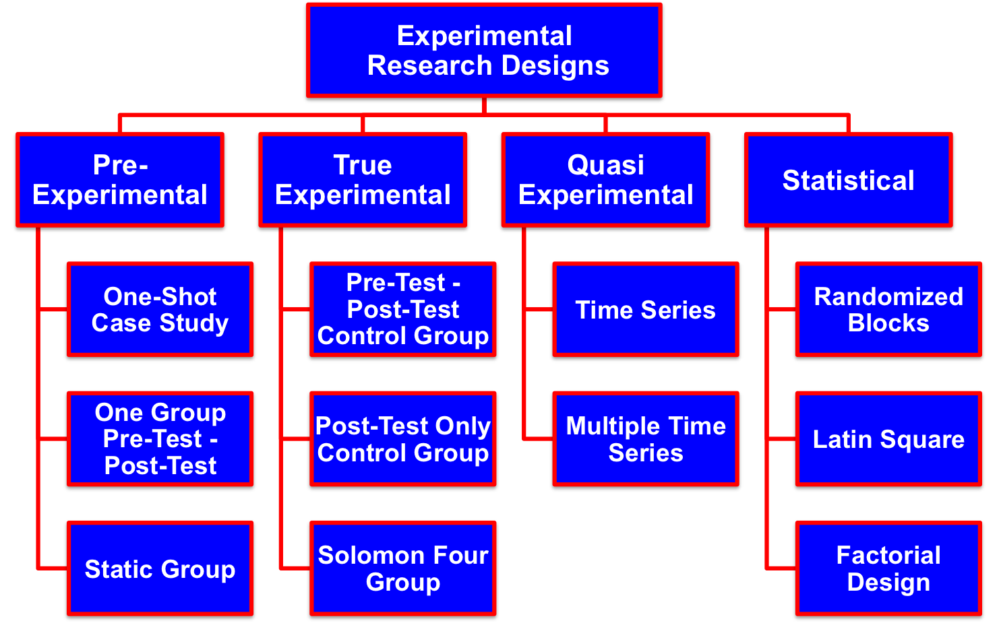
Types of Experimental Research Designs

Slide 11
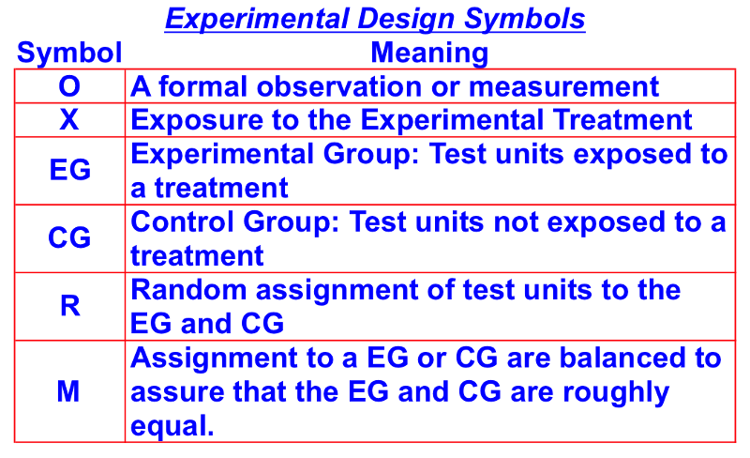
Experimental design-symbols

Slide 12
Pre-Experimental Designs
Pre-Experimental Designs are the simplest form of experimental research designs
Pre-experimental designs have little or no control over extraneous variables
These designs do not randomly assign subjects to different treatments
As a consequence, the results of a test using a pre-experimental design are difficult to interpret
These designs are simple and relatively inexpensive
Eg; Efficacy of work experience in enhancing academic performance

Slide 13

Pre-Experimental Designs
A)One-Shot Case Studies:
With a one-shot case study subjects—are exposed to a treatment
The standard notion for a treatment is the symbol "X."
A single measurement of the dependent variable is taken (O₁)
There is no random assignment of test subjects as there is only one treatment, and there is no control
The standard notation for a One-Shot Case Study

Slide 14

Pre-Experimental Designs
B)One Group Pre-Test - Post-Test:
With this research design the test unit is measured twice
one before the test and once after the test
There is still no control group; which is to say, a group not receiving the treatment
Here is the standard notation for a one-group pre-test - post-test study:

Slide 15
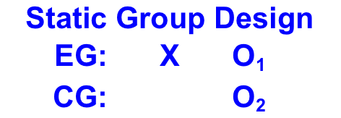
Pre-Experimental Designs
C. Static Group Design:
With the Static Group design there is a Control Group (CG) in addition to the Experimental Group (EG)
The experimental group is exposed to the treatment while the control group is not
Test units, however, are not randomly assigned to the control or experimental groups
Here is the standard notation for a Static Group study:

Slide 16
True Experimental Designs
True experiments are considered the most accurate form of experimental research
This design is used to prove or disprove a hypothesis, or theory.
True experiments are excellent for showing a cause-and-effect relationship
There is a random assignment of subjects or groups to treatments
In true experiments with only one variable manipulated and tested
Random assignment controls for extraneous variables
The strength of true experiments is causal control and strong internal validity
They are high on internal validity and variable being measured is clear
Eg;Effectiveness of experiential learning in enhancing process skills

Slide 17
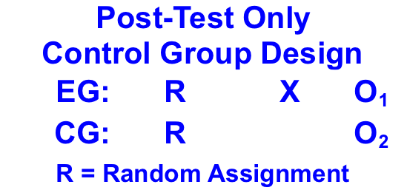
True Experimental Designs
A. Post-Test Only Control Group Design:
With this research design, test units are randomly assigned to the experimental and control groups
The experimental group is exposed to the treatment and then both the experimental and control groups are measured
There is only one measurement is taken
The standard notation for a Post-Test Only study:
The effect of the treatment is calculated
as O₁ - O₂.

Slide 18
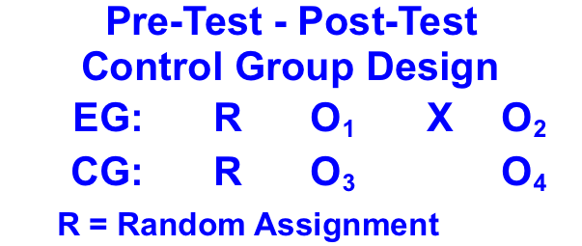
True Experimental Designs
B. Pre-Test - Post-Test Control Group Design:
With this research design, test units are randomly assigned to experimental and control groups
A pre-test measure is taken from both groups
Here is the standard notation for a Pre-Test - Post-Test Control Group study:
The treatment effect is measured by (O₂ O₁) - (O₄ O₃)

Slide 19
True Experimental Designs
C. Solomon Four Group Design:
The Solomon Four Group Design is a research design that assesses the impact of pretesting on subsequent measures
It is used when the researcher suspects that earlier tests influence the results of later tests
With this research design, test units are randomly allocated to two experimental groups and two control groups
One of the experimental groups and one of the control groups is measured
Both experimental groups are then exposed to a treatment

Slide 20
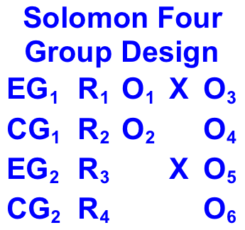
True Experimental Designs
Afterwards, both experimental and control groups are measured
A total of six measurements are taken
The design aims to account for pre-testing bias and pre-test manipulation interaction bias
The standard notation for a Solomon Four Group study:

Slide 21
Quasi-Experimental Designs
Quasi-Experimental Designs are used when the researcher creates an artificial environment to control for extraneous variables
With quasi-experimental designs, the research lacks control over when the treatment is administered or assigns test units to the experimental and control groups in a non-random fashion
Eg;Effectiveness of a motivation intervention on class attendance and enjoyment in students.
There are two basic types of quasi-experimental designs:
Time Series and Multiple Time Series.

Slide 22

Quasi-Experimental Designs
Time Series:
There is no randomization of the test units to the treatments
The timing of the treatment presentation as well as which test unites are exposed to the treatment may not be within the researcher's control
The advantages of Time Series are that it is easier to interpret the results than a One Group Pre-Test - Post-Test design because of the many measures it takes

Slide 23
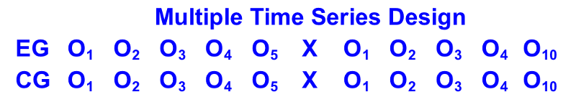
Quasi-Experimental Designs
B. Multiple Time Series:
With the Multiple Time Series, the researchers add a control group to the research design
The addition of a control group enhances the researchers' ability to discern the treatment effect
Here is the standard notation for a Multiple Time Series study:

Slide 24
Statistical Designs
Statistical Designs are a collection of basic experimental designs that offer researchers the ability to statistically control and analyze external variables
Statistical control uses various sophisticated statistical techniques to exclude the influence of extraneous variables from an analysis
The most commonly used Statistical Research Designs are the Randomized Block Design, the Latin Square Design, and the Factorial Design.

Slide 25
Statistical Designs
A)Randomized Block Design
With a randomized block design, the experimenter divides subjects into subgroups called blocks
The subjects within each block are randomly assigned to treatment condition
This design reduces variability within treatment conditions
produce a better estimate of treatment effects

Slide 26
Statistical Designs
Subjects are assigned to blocks, based on gender
within each block, subjects are randomly assigned to treatments
50 males/50 females taught by constructivist model, 50 males/ 50 females by activity oriented method
This design ensures that each treatment condition has an equal proportion of males and females. As a result, differences between treatment conditions cannot be attributed to gender
GENDER | TREATMENT CONSTRUCTIVIST MODEL | ACTIVITY ORIENTED
male | 50 | 50
female | 50 | 50

Slide 27
Statistical Designs
B)Factorial Design
It is often used by scientists wishing to understand the effect of two or more independent variables upon a single dependent variable
Factorial experiments allow subtle manipulations of a larger number of interdependent variables
The factorial design, as well as simplifying the process and making research cheaper, allows many levels of analysis
Highlighting the relationships between variables, it also allows the effects of manipulating a single variable to be isolated and analyzed singly
Eg; Efficacy of self-regulated learning on metacognitive abilities of males and females differently (independent variable-self-regulated learning dependent variables –gender &metacognitive ability)

Slide 28
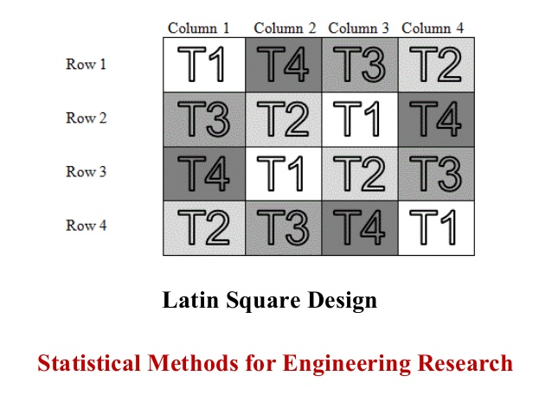
Statistical Designs
C)Latin square design
An experiment design that can be used to control the random variation of two factors.
The design is arranged with an equal number of rows and columns, so that all combinations of possible values for the two variables can be tested multiple times
This design is used to reduce the effect of random or nuisance factors.

Slide 29
Strengths of experimental designs
. It provides researchers with a high level of control Each variable can be controlled on its own or in different combinations to study what possible outcomes are available for a product, theory, or idea
There is no limit to the subject matter It can be used in a wide variety of situations. Teachers might use experimental research to determine if a new method of teaching or a new curriculum is better than an older system
Experimental research provides conclusions that are specific Because experimental research provides such a high level of control, it can produce results that are specific and relevant with consistency
The results of experimental research can be duplicated
. This allows anyone to be able to check and verify published results

Slide 30
Strengths of experimental designs
Experimental research allows cause and effect to be determined The manipulation of variables allows for researchers to be able to look at various cause-and-effect relationships that a product, theory, or idea can produce
It can be combined with other research methods. This allows experimental research to be able to provide the scientific rigor that may be needed for the results to stand on their own
Natural settings can be replicated with faster speeds This allows researchers to have a greater control of the extraneous variables which may exist as well, limiting the unpredictability of nature as each variable is being carefully studied.

Slide 31
Limitations of experimental research
Results are highly subjective due to the possibility of human error Experimental research requires specific levels of variable control, it is at a high risk of experiencing human error at some point during the research
Experimental research can create situations that are not realistic The variables of a product, theory, or idea are under such tight controls that the data being produced can be corrupted or inaccurate, but still seem like it is authentic
It is a time-consuming process Experimental research isolate each variable, conduct testing on it and combinations of variables must also be considered. This process can be lengthy and require a large amount of financial and personnel resources.

Slide 32
Limitations of experimental research
Extraneous variables cannot always be controlled Although laboratory settings can control extraneous variables, natural environments provide certain challenges
Participants can be influenced by their current situation Human error isn’t just confined to the researchers. Participants in an experimental research study can also be influenced by extraneous variables
eg; stress, fatigue
Manipulating variables isn’t necessarily an objective standpoint
For research to be effective, it must be objective. Being able to manipulate variables reduces that objectivity
Human responses in experimental research can be difficult to measure.
There are many pressures that can be placed on people, from political to personal, and everything in-between. Different life experiences can cause people to react to the same situation in different ways.

Slide 33
summary
Experimental research designs are often considered to be the standard in research designs.
In this research design, one or more subjects or dependent variables are randomly assigned to different treatments
The independent variables manipulated by the researcher and the results are observed to conclude.
One of the uniqueness of experimental research is in its ability to control the effect of extraneous variables.
Experimental research is suitable for research whose goal is to examine cause-effect relationships.
It can be conducted in the laboratory or field settings, depending on the aim of the research that is being carried out.

Slide 34
Suggested readings
Kothari, C.R.(1985). Research Methodology- Methods and Techniques. New Delhi: Wiley Eastern Limited.
Kumar, Ranjit.( 2005).Research Methodology-A Step-by-Step Guide for Beginners(2nd .ed) .Singapore :Pearson Education.
Neuman, W,L; & Neuman, W.L. (2006). Social Research Methods: Qualitative and Quantitative Approaches. Toronto: Pearson.
Punch, K.F. (2013). Introduction to Social Research: Quantitative and Qualitative Approaches. Sage Publications

Slide 35


